Slide 1


CRM ANALYTICS
BY GROUP 3
TEAM MEMBERS :-
1. Pranay Mangesh Gawade
2. Nikita Saroj
3. Koneru Joshna
4. Booka Hemanth sai
5. Budaraju Praneetha
6. Mallikarjuna Kagula

Slide 2
SUMMARY OF THE PROJECT
This project analyzes CRM data to track lead conversion, sales pipeline performance, and revenue trends.
Using SQL, data from Leads, Accounts, Opportunities, Products, and Users was cleaned, joined, and transformed into key KPIs such as conversion rate, win rate, and expected revenue.
The insights were visualized using Power BI, Tableau, and Excel through Lead and Opportunity dashboards, enabling data-driven sales decisions.

Slide 3
KPI LIST
LEAD DASHBOARD
OPPORTUNITY DASHBOARD
Total Lead
Expected Amount from Converted Leads
Conversion Rate
Converted Accounts
Converted Opportunities
Lead By Source
Lead By industry
Lead by Stage
Expected Amount
Active Opportunities
Conversion Rate
Win Rate
Loss Rate
Expected Vs Forecast
Active Vs Total Opportunities
Closed Won Vs Total Opportunities
Closed Won Vs Total Closed
Expected Amount by Opportunity Type
Opportunities by Industry

Slide 4
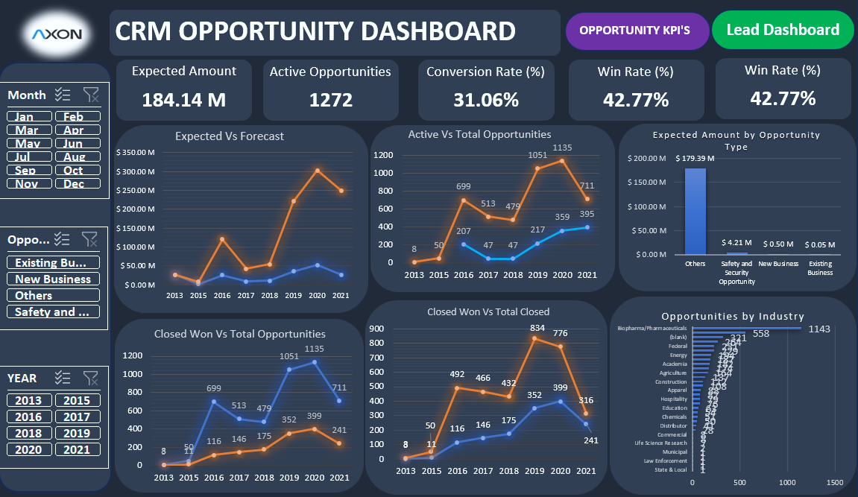
EXCEL DASHBOARD

Slide 5
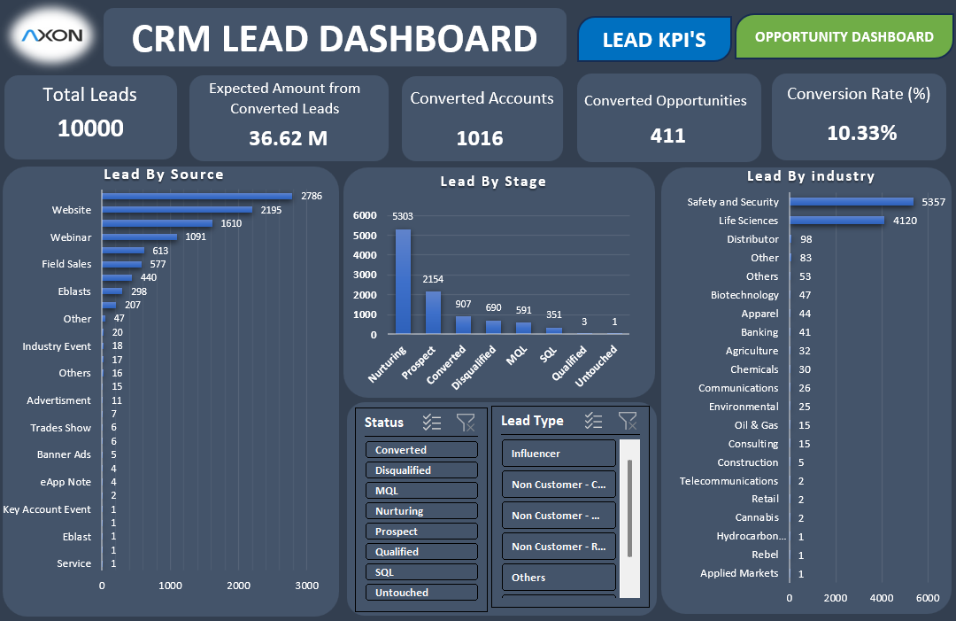
EXCEL DASHBOARD

Slide 6
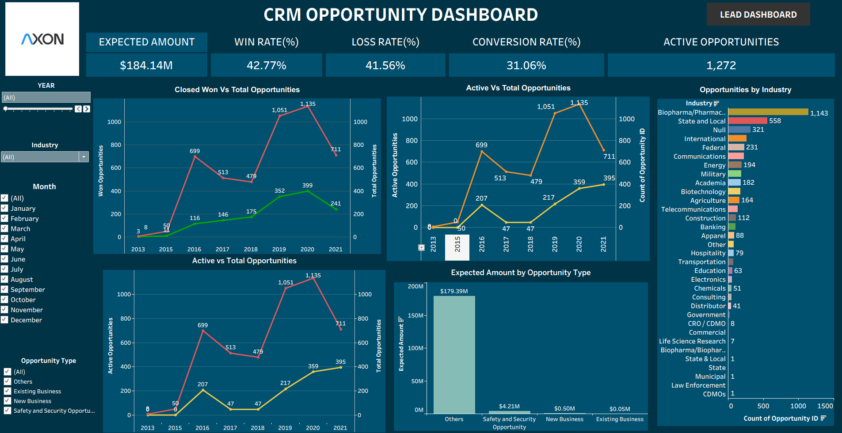
TABLEAU DASHBOARD

Slide 7
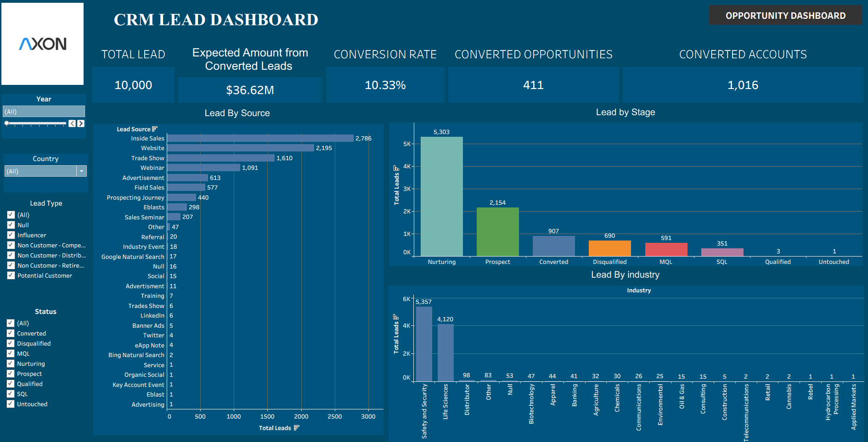
TABLEAU DASHBOARD

Slide 8
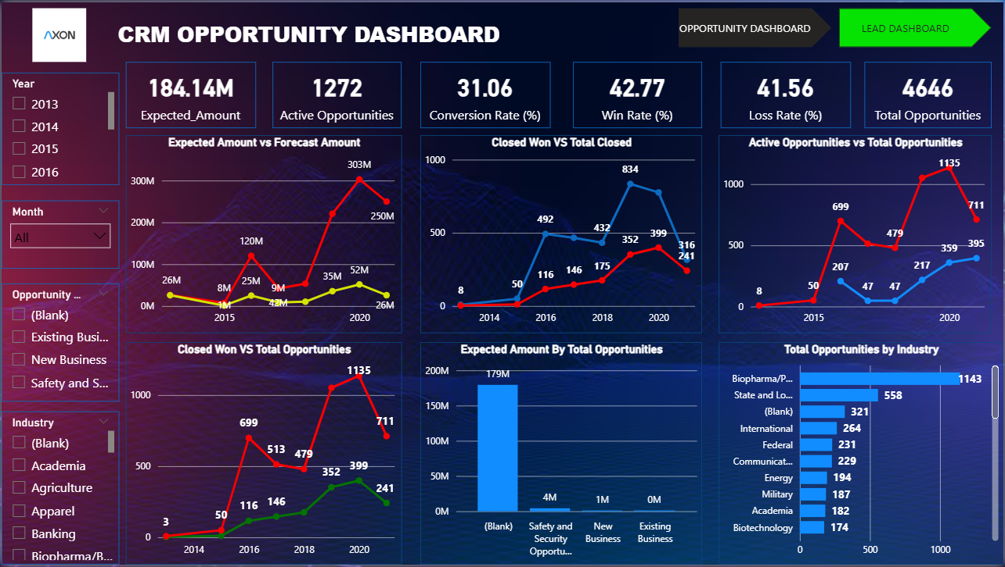
POWERBI DASHBOARD

Slide 9
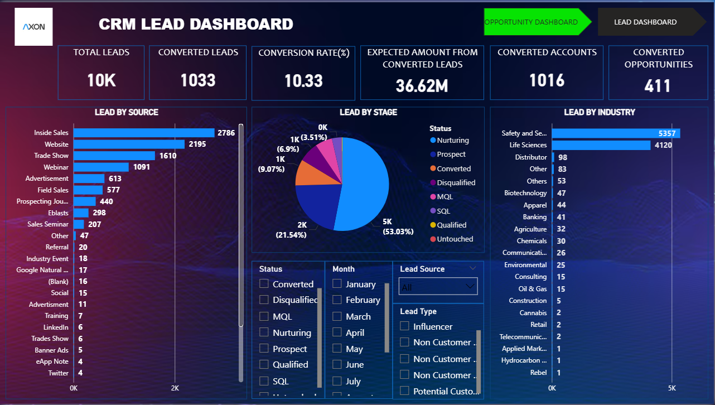
POWERBI DASHBOARD

Slide 10
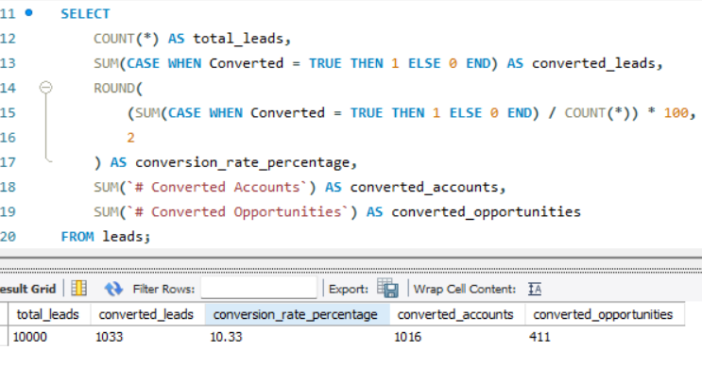
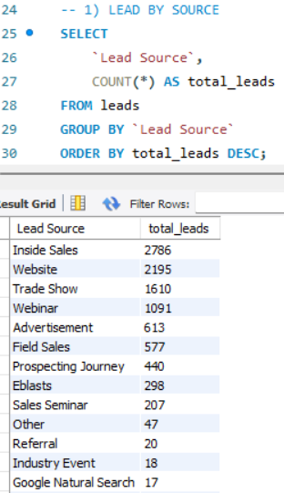
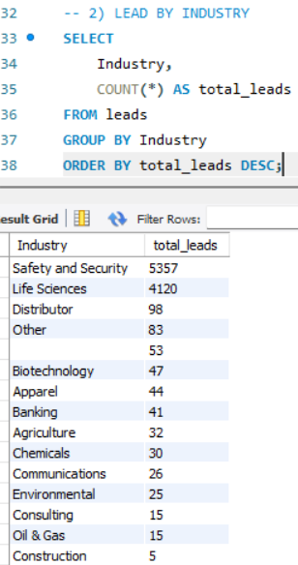
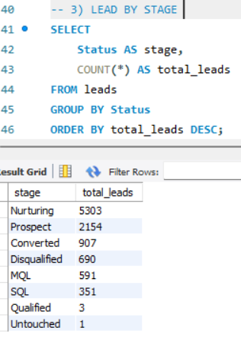
SQL QUERIES
SQL QURIES FOR LEAD KPI’S

Slide 11
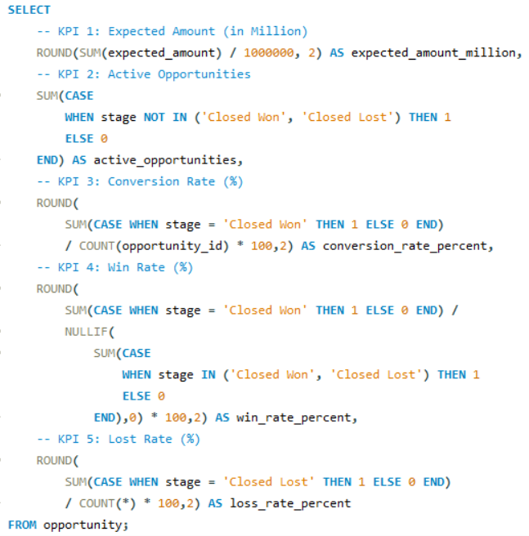
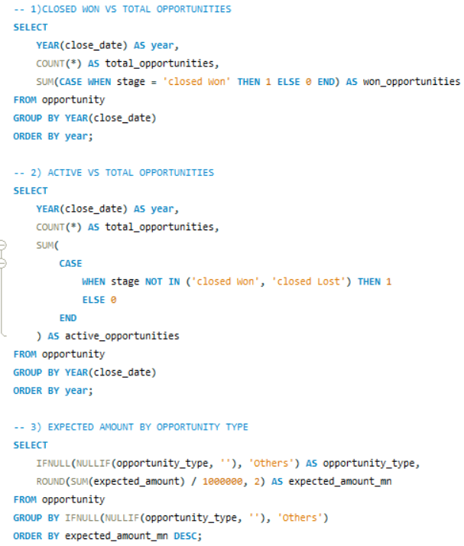
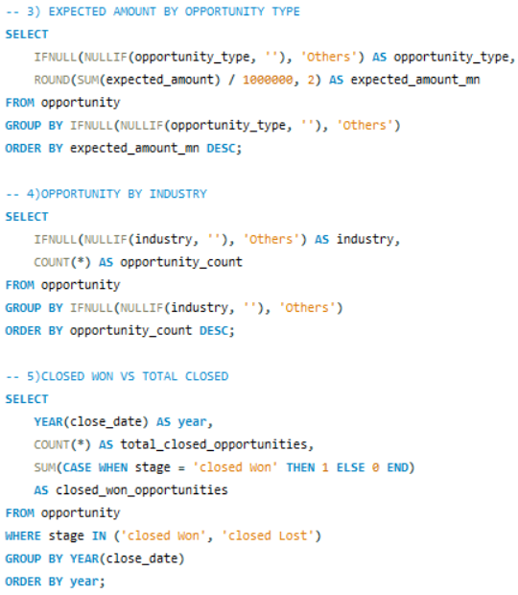
SQL QURIES FOR OPPORTUNITY KPI’S

Slide 12
KEY TAKEAWAYS
Conversion and win rates clearly indicate the effectiveness of the sales funnel from lead generation to deal closure.
Active opportunities highlight strong pipeline potential but require timely follow-ups to improve closures.
Expected amount trends help in comparing revenue potential against forecasts and identifying gaps early.
Industry- and source-wise lead analysis reveals high-performing segments and underperforming channels.
Loss rate analysis uncovers key challenges in deal conversion and areas needing process or strategy improvement.
Trend analysis supports data-driven decision-making and improves future sales forecasting accuracy.
Focusing on high-conversion lead sources and industries can significantly boost revenue outcomes.

Slide 13
THANK YOU

